Slide 1
Raytheon
Andy, Ayden, Nathan, Stephen, Hunter
Hunter

Slide 2




Overview
What does nearly all social media do?
Provides a space that supports the sharing of text, images, or videos
Provides user interaction that supports communities and collective interests
What our app does
Allows any type of file to be shared, anything digital can be posted to the app
Supports user interaction to build communities around any type of interest
Nathan

Slide 3
In-scope for version 1.0
Fundamental functionality:
Supports uploading and downloading of popular file types
A timeline to scroll through posts
User interactions such as likes, dislikes
Potential secondary functionality:
A built-in media player so external software isn’t needed to consume content
Tag-based posts that allow for fast and easy searching and filtering
Additional user interactions like comments and replies
Nathan

Slide 4
Out-of-scope for 1.0
Additional features:
Different pages that display content of a specific type or theme
Multi-user tagging on single posts
Private-chats
Personalized algorithmic content feeds
Encryption for private posts or chats
Nathan

Slide 5



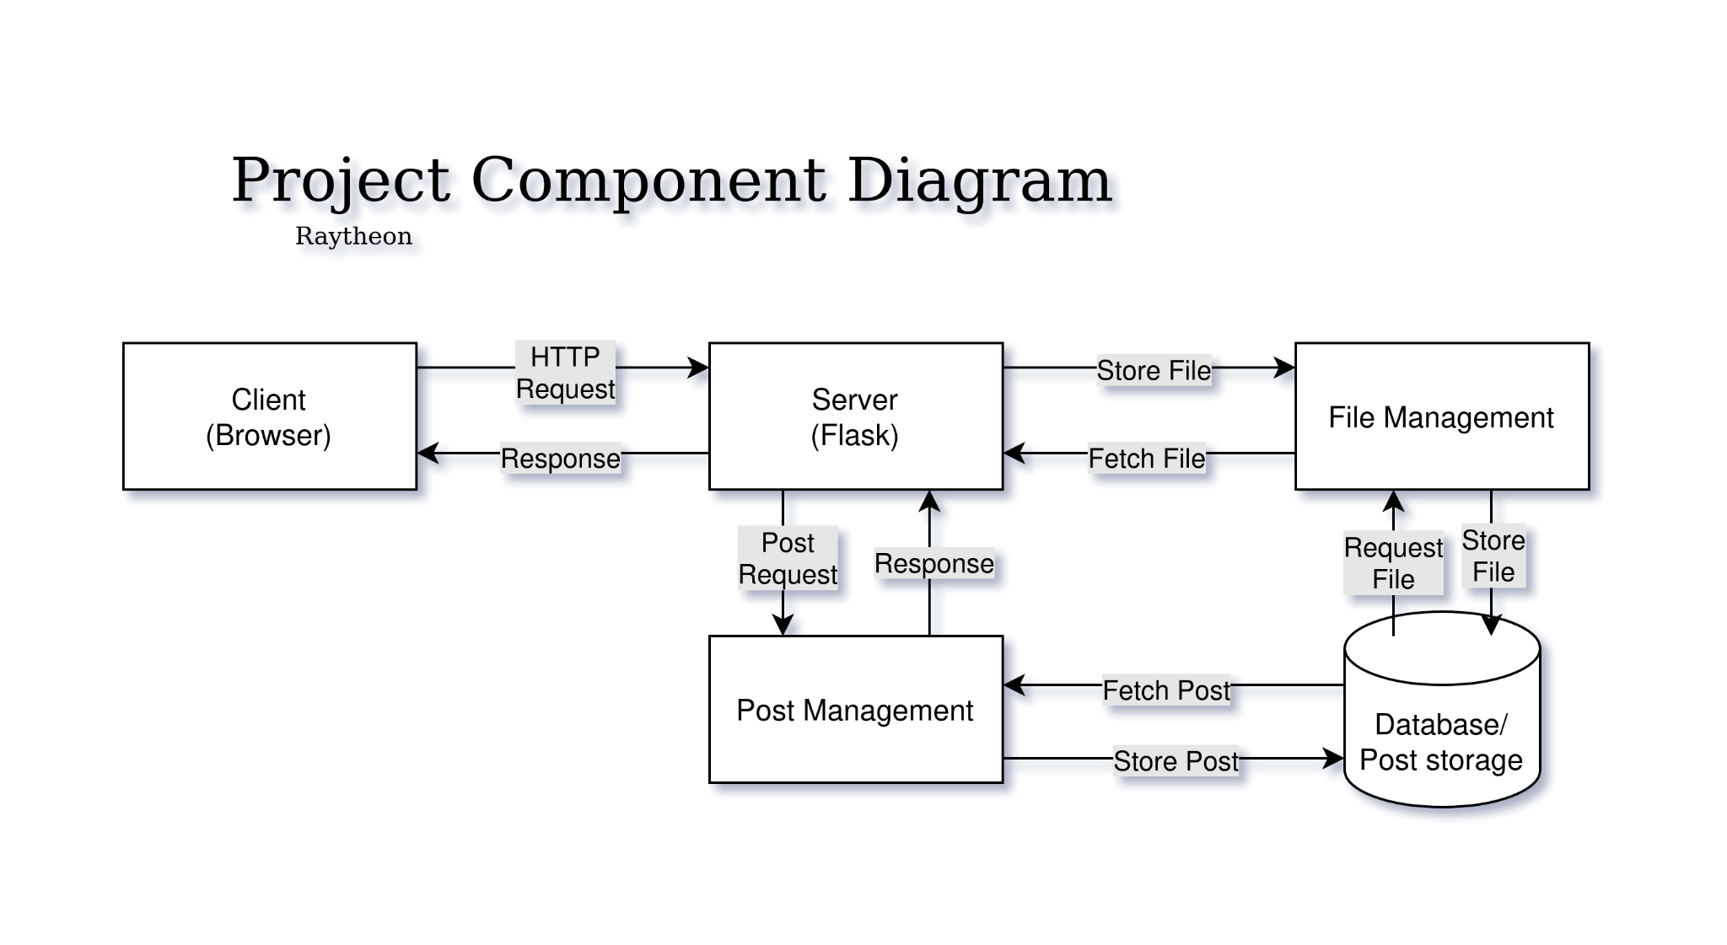

Solution Architecture
Dependencies:
flask
tinydb
timeago
markdown2
hashlib
Architecture? What the hek is flask? Build the web-ui how? What is .css? Can I eats it?
Stephen
Notes:
Stephen Harris
5. Solution Architecture - Show your component diagram, talk about the technology choices. Include any dependencies on other libraries or 3rd party tools. I know that many people's diagrams will look similar - yours should differ from theirs only really if you're doing something external. I want you to practice explaining your architecture - talk about how flask works, talk about how the web-ui will be built out. What will you do with the existing .css? (use it as is, enhance it or replace it?)

Slide 6
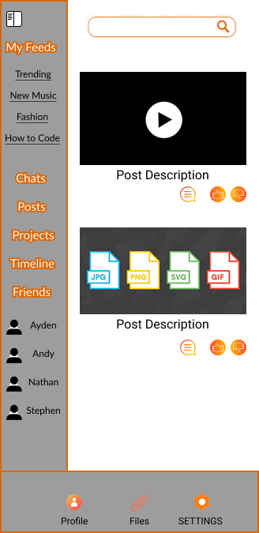
UI mock up
Link to UI prototype - https://www.figma.com/design/Kb6dVSZk6uqnnsqNfBAT3r/App-Prototype?node-id=0-1&t=t6b92wZnxzupDfHG-1
Andy

Slide 7
Summary and conclusion - Ayden
Why should you use our app instead of other social media platforms, such as Instagram, Discord, ETC?
Integrated environment
No filter on file formats
Our app will allow for infinite possibilities for the end user
Stack overflow type community
Simple user interface
Notes:
Integrated environment - It does the same things as all of those apps and more, in one “”
No filter - No other app allows file posting without format filters Simple user interface - Our user interface is designed to take you anywhere within the app in one to two actions

Slide 8

Q&A -Ayden

